Slide 1
RICH Mirror Alignment
07/01/2016 Claire Prouve - University of Bristol LHCb UK Liverpool
presenting work by Anatoly, Antonis, Chris, Claire, Paras, Roel, and many more

Slide 2
Overview
RICH mirror alignment strategy
RICH mirror alignment implementation in Run II
Performance in Run II
RICH maintenance and operation

Slide 3
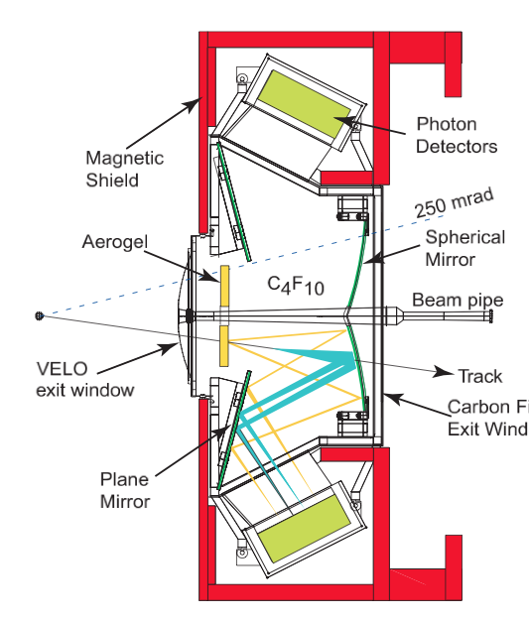
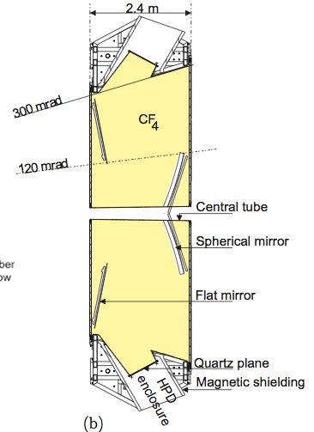
RICH Mirror Alignment
RICH 1:
RICH 2:
4 primary mirrors
16 secondary mirrors
54 primary mirrors
40 secondary mirrors
Photon Detectors
Photon Detectors
Secondary mirrors
Secondary mirrors
Primary mirrors
Primary mirrors
No more Aerogel!
x
x
Misaligned mirrors will affect the PID due to incorrectly predicted Cherenkov angle!

Slide 4
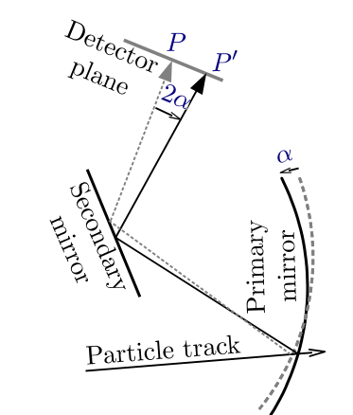
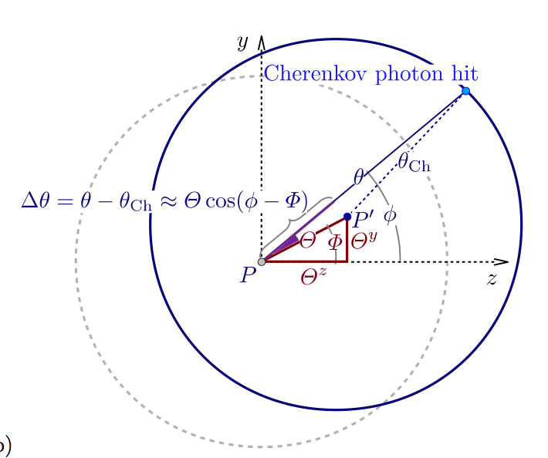
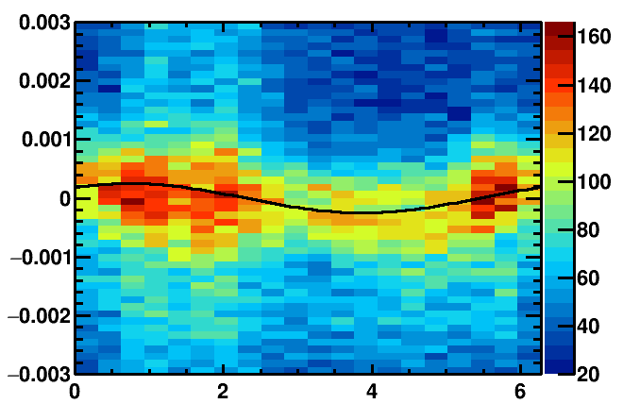
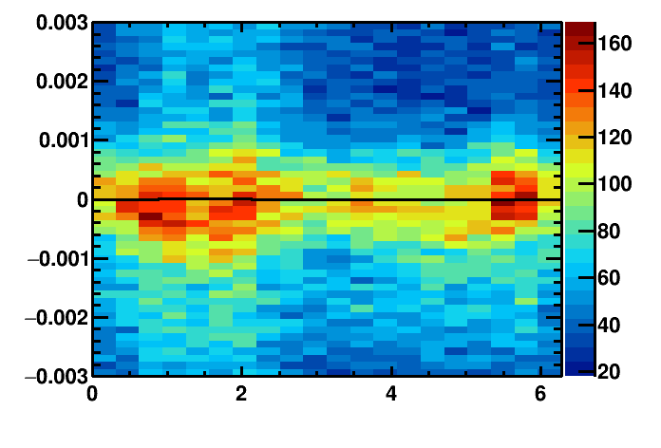
Misalignment
Detector plane
Identify misalignment:
Misalignment
Δθ_{C}(Φ) = θ_{meas.}- θ_{exp.}
Δθ_{C}(Φ) = ρ_{y} cos(Φ) + ρ_{z} sin(Φ)
Proj. Track position
Real track position
Misalignments on detector plane
Misaligned mirror:
Aligned mirror:
Cherenkov angle resolution / rad
Cherenkov angle resolution / rad
azimuthal angle/ rad
azimuthal angle/ rad

Slide 5
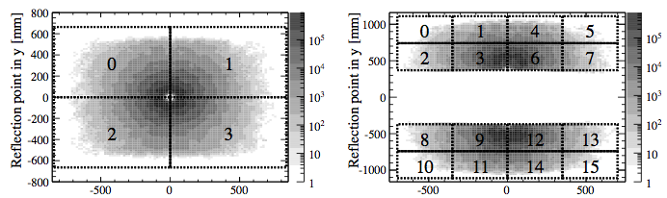
Decoupling misalignments
Mirror-pair: fit misalignment on detector-plane in y, z ➔ 2 parameters
need actual misalignment in y,z, for each mirror
➔ 4 parameters
RICH1: easy!
Given secondary mirror only receives photons from one primary mirror.
➔ Only align secondary mirrors
Primary mirrors
Secondary mirrors

Slide 6
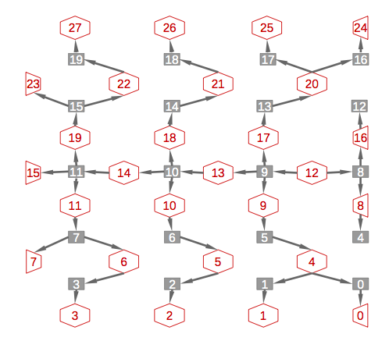
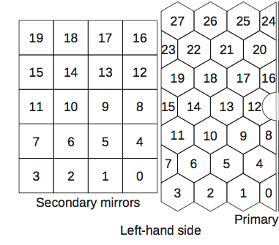
Decoupling misalignments
Mirror-pair: fit misalignment on detector-plane in y, z ➔ 2 parameters
need actual misalignment in y,z, for each mirror
➔ 4 parameters
RICH2:
Given secondary mirror can receive photons from several primary mirrors.
System of equations linking all mirrors starting from primary mirror 12.
Andrew Cook
primary mirrors, secondary mirrors

Slide 7
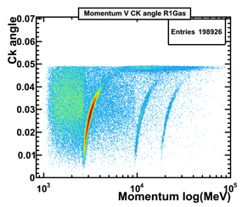

Alignment procedure
High energy tracks + reconstruct under pion- hypothesis
Fill histograms with (Δθ vs. Φ) of unambiguous photons for each mirror- pair
Events
Unambiguous photons will be reflected by the same mirror-pair no matter where along the track they were emitted.
CONDDB database
Calculate mirror misalignments for each individual mirror + Update database
Determine misalignment on detector plane
new database

Slide 8
Alignment procedure
High energy tracks + reconstruct under pion- hypothesis
Fill histograms with (Δθ vs. Φ) of unambiguous photons for each mirror- pair
Events
Unambiguous photons will be reflected by the same mirror-pair no matter where along the track they were emitted.
CONDDB database
Any mirror moved > 0.1 mrad?
Calculate mirror misalignments for each individual mirror + Update database
Determine misalignment on detector plane
new database

Slide 9

Alignment procedure
High energy tracks + reconstruct under pion- hypothesis
Fill histograms with (Δθ vs. Φ) of unambiguous photons for each mirror- pair
Events
Unambiguous photons will be reflected by the same mirror-pair no matter where along the track they were emitted.
new database
YES!
Calculate mirror misalignments for each individual mirror + Update database
Determine misalignment on detector plane
new(er) database

Slide 10
Alignment procedure
High energy tracks + reconstruct under pion- hypothesis
Fill histograms with (Δθ vs. Φ) of unambiguous photons for each mirror- pair
Events
Unambiguous photons will be reflected by the same mirror-pair no matter where along the track they were emitted.
new database
Any mirror moved > 0.1 mrad?
Calculate mirror misalignments for each individual mirror + Update database
Determine misalignment on detector plane
new(er) database

Slide 11
Alignment procedure
High energy tracks + reconstruct under pion- hypothesis
Fill histograms with (Δθ vs. Φ) of unambiguous photons for each mirror- pair
Events
Unambiguous photons will be reflected by the same mirror-pair no matter where along the track they were emitted.
new database
No! ➔ Alignment converged!!!
Calculate mirror misalignments for each individual mirror + Update database
Determine misalignment on detector plane
new(er) database

Slide 12
RICH mirror alignment implementation in Run II

Slide 13
Run I and Run II
Run I:
Offline, after data taking
with Ganga for the Brunel reconstruction
Alignment applied at the end-of-year reprocessing
Run II:
Online: after HLT1 and before HLT2
Alignment run for each Fill (monitoring mode)
HLT1 lines for alignment
HLT farm (~1700 nodes)
Steered by the online Finite State Machine (FSM)

Slide 14
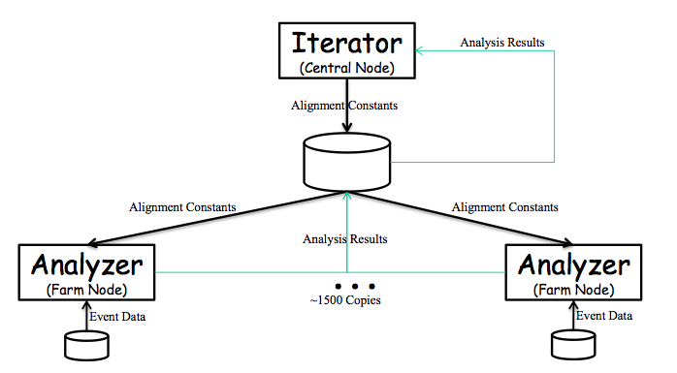
HLT farm for Run II
HLT farm nodes (Analysers)
Reconstruct data from HLT1 lines
Make the histograms
Central node (Iterator)
Receives histograms from Analysers
Determines misalignment on detector plane
Determines misalignment of each individual mirror
Makes new database + decides weather or not to continue
Beat Jost
HLT farm

Slide 15
Finite State Machine
Iterator
Run Control
Analyzer(s)
Get default database and place where analyzers will pick it up, etc.
configure
configure
CONFIGURING
CONFIGURING
Set up Brunel reconstruction options.
READY
READY
start
start
Mirror misalignments + new database.
In case of continue: place new database where the analyzers will pick it up.
RUNNING
RUNNING
Reconstruct events and fill histograms.
PAUSED
stop
pause
READY
PAUSED
RUNNING
start
RUNNING
Reconstruct events and fill histograms.
stop
pause
READY
Alignment converged!
PAUSED
READY

Slide 16
Performance in Run II

Slide 17
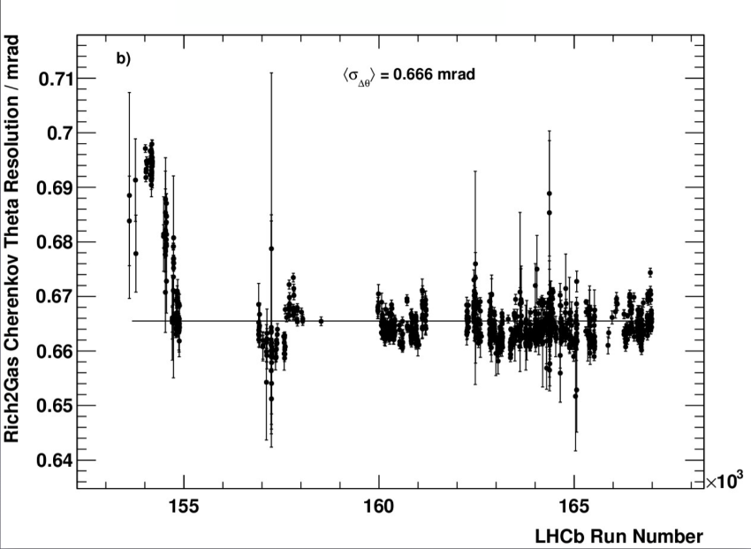
Performance – RICH2
RICH2 Cherenkov Resolution Stability : 2015
Run I:
<σ_{Δθ}> ~ 0.67 mrad
Run II average: <σ_{Δθ}> ~ 0.67 mrad
Chris Jones
Early measurements

Slide 18
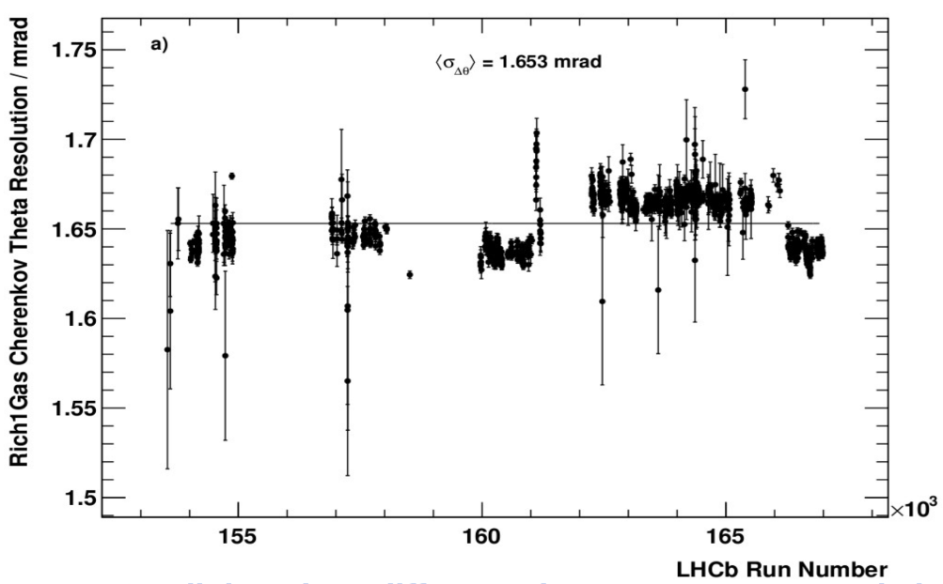
Performance – RICH1
RICH1 Cherenkov Resolution Stability : 2015
Run I:
<σ_{Δθ}> ~ 1.62 mrad
Run II average: <σ_{Δθ}> ~ 1.65 mrad
Magnet down
Magnet up
Chris Jones
Chris Jones
Small but clear differences between magnet up and magnet down!

Slide 19
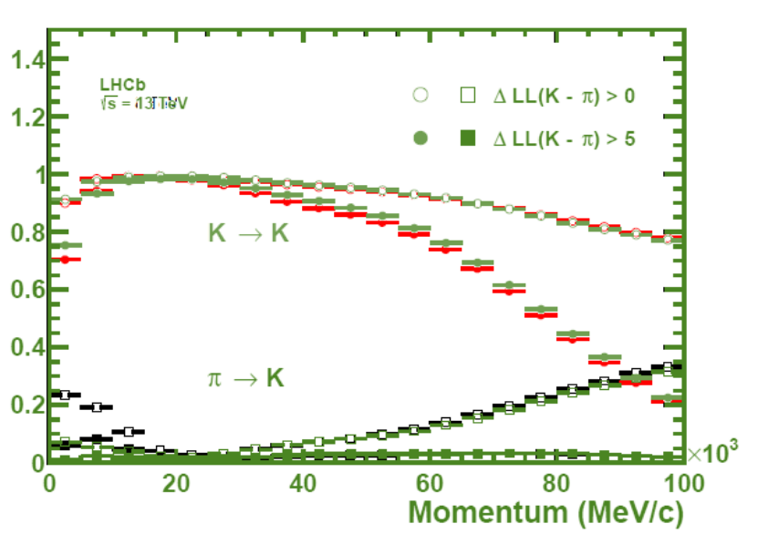
PID Performance
Run I:
Run II:
Δ LL (K – π) > 0
Sneha Malde
Δ LL (K – π) > 5

Slide 20
Maintenance and operation

Slide 21
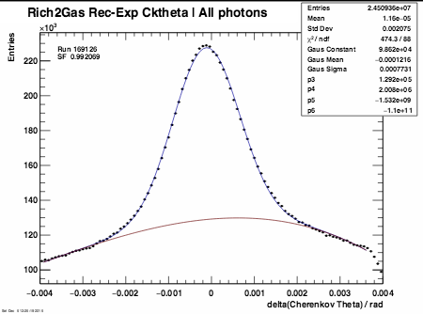
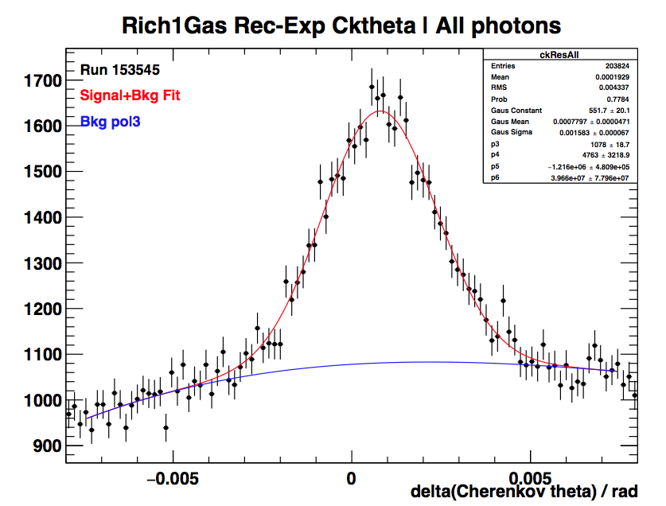
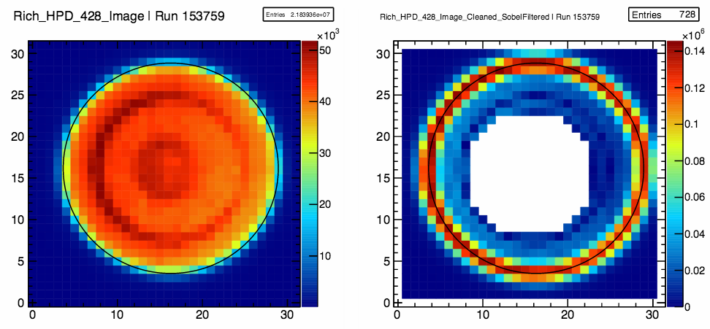
Calibrations
Online calibrations at the end of each run.
Refractive Index Calibration:
Hardware sensors monitor pressure and temperature.
Limited precision and does not account for gas mixture changes.
Simple fit to reconstructed-expected Cherenkov angle yields (n-1) scale factor.
HPD images calibration:
Image fit performed for each HPD and used to provide calibration for anode element.
Sobel Filter

Slide 22
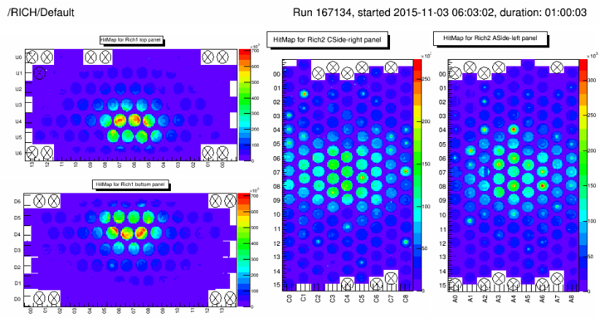
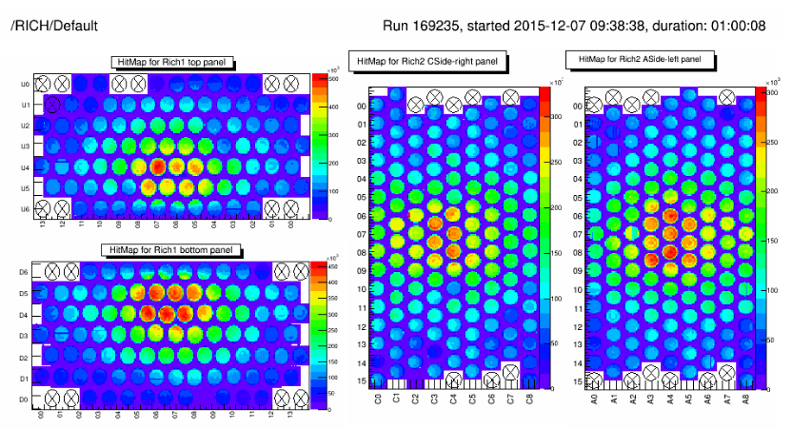
Maintenance and Operation
Aerogel in RICH1 removed
~50% of HPDs in RICH1 replaced and many in RICH2 ➔ quite new detector
Gas leak in RICH1: not found but workaround developed
Gas pressure generally well handled
Some incomplete events due to RICH detectors ➔ bug in UKL0 firmware found and fixed
RICHes performed well during the heavy ion runs
Average pp event:
Average heavy ion event:

Slide 23
Summary
RICH detectors are performing very well
Alignment will be run online for every fill
PID can be used in HLT2
Very fast (<2h wrt. ~2 days)
RICH2 reached precision of RunI already
RICH1 needs a bit more work
More optimisation is being done

Slide 24
Backup

Slide 25
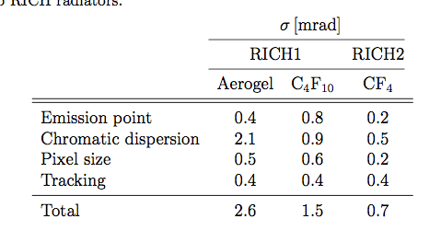
Cherenkov angle resolution
Limiting factors to Cherenkov angle resolution:

Slide 26
Misalignment
Misaligned mirrors:
Aligned mirrors:
Δθ [rad]
Δθ [rad]
Φ [rad]
Φ [rad]
Signal:
Gaussian
BKG:
2nd order polynomial
26

Slide 27



Magnification coefficients
Magnification coefficients: Translate the tilt on the detector plane into actual mirror tilts
Magnification coefficients are calculated new for each iteration:
Introduce 8 rotations: primary and secondary mirrors rotated around ±y and ±z axis respectively
Rotate about 0.3 mrad ( half the resolution of RICH2)
Reconstruct events for each rotation and evaluate the tilts on the detector plane
Need to reconstruct all events 9 times!
Misalignments on detector plane
Mirror tilts

Slide 28
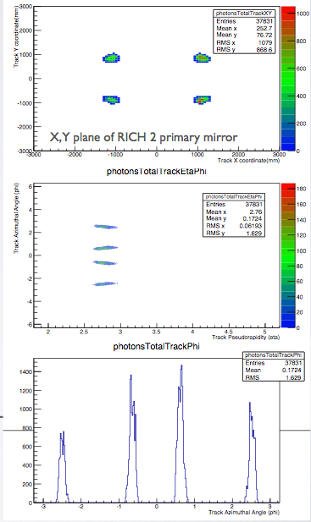
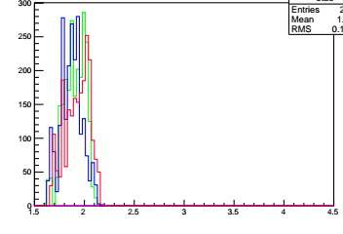
New HLT Lines
Trigger on tracks that will populate the hardest-to-populate mirror-pairs
usually the very outer mirrors
Other tracks in the events will populate the rest
RICH2
Track azimuthal angle / rad
RICH2 line:
p > 40 GeV && χ² < 2 && 2.65 < η < 2.80
(-2.59 < Φ < -2.49) || ( -0.65 < Φ < -0.55) || (0.45 < Φ < 0.65) || (2.49 < Φ < 2.59)
Track pseudorapidity
RICH1
RICH1 line:
p > 10 GeV && χ² < 2 && 1.6 < η < 2.04
(-2.65 < Φ < -2.3) || (-0.8 < Φ < -0.5) || (0.5 < Φ < 0.8) || (2.3 < Φ < 2.65)
Need to reconstruct ~10 times less events!
Track pseudorapidity

Slide 29
Example RICH1 improvement
First alignment in RunII
Second alignment in RunII

